Slide 1
CS 360 Presentation Oct. 18 NoDD
Andrew Plum and Nathan Nguyen
plum0598@vandals.uidaho.edu
nguy7866@vandals.uidaho.edu

Slide 2
Our Project: Improving NoDD
We are expanding upon the already existing NoDD interactive web framework.
We are implementing the evaluation algorithm which grades student responses concerning the normalization of functional dependencies.

Slide 3
Functional Dependencies and Normalization
Functional dependencies
These are a key concept in database design.
When the values of some attributes in a database uniquely determine the values of other attributes in the database, we say they are functionally dependent.
Example: A --> B and B --> C, then A --> C
A database contains attributes "Date of birth" and "Age" and "Is minor"
"Date of birth" --> "Age"
"Age" --> "Is minor"
Therefore "Date of birth" --> "Is minor"
Normalization
Is the process of organizing data in a database in order to reduce ambiguity, redundancy, and ensure consistency.
There are two main normalization algorithms that exist for functional dependencies: the 3NF algorithm and the BCNF algorithm.

Slide 4
Project Phases
Connect with app interface for inputs
Interpret data
Structing
Implement algorithm
Evaluating for 3NF and BCNF
Output data

Slide 5





Software and Tools
Programming Languages Used
We're using:
HTML
php
Development Tools
Some include:
Visual Studio Code
Git/GitHub
Notepad++

Slide 6
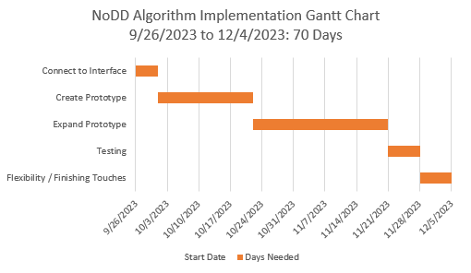
Schedule
On track to meet the deadlines we created.

Slide 7
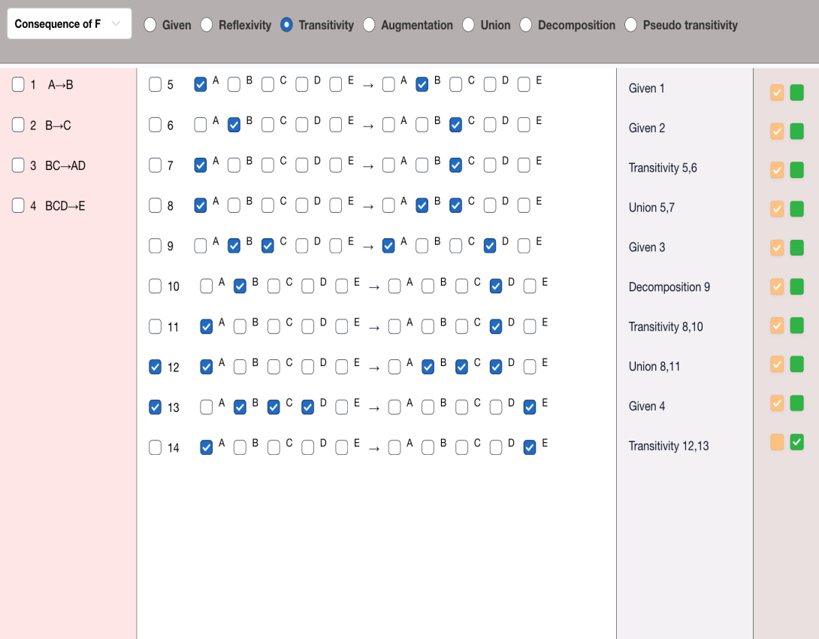
Why Create a Prototype
This image is of the interface from last semester.
It his heavily integrated with the website.
We designed a similar dummy interface to act as a prototype.
Will integrate the code of the prototype with the project from last semester
Concept should be consistent

Slide 8
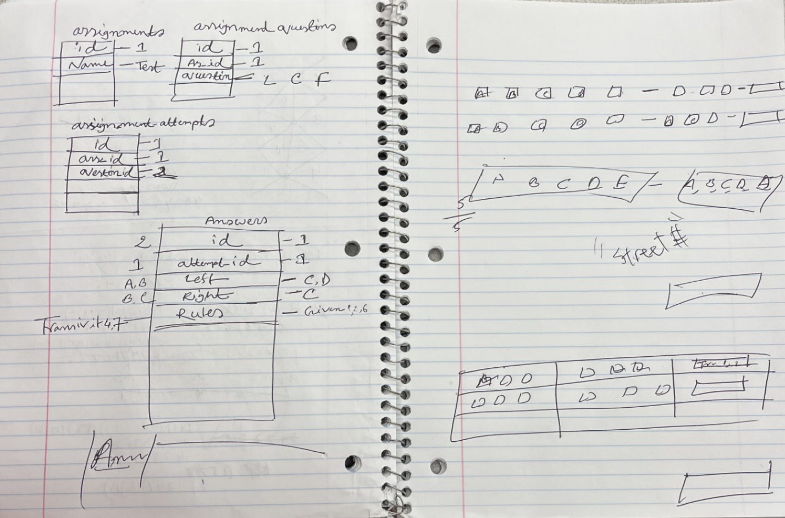
Our Prototype
First, we designed the interface using html
Then we created the database
Finally, we connected the database and the interface with php on the backend.
Let’s look at the code

